Slide 1
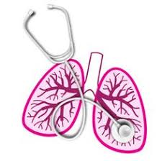
University of Basrah Al-zahraa medical college
Ministry of Higher Education and Scientific Research
Respiratory system module Academic year 2021-2022 2^{ed} year S 4
Session: Lecture: COPD
Chemical control of breathing
Module staff:
Dr. Nehaya Mnahi
[module leader]
Dr. Ahmed Badr
Dr. Nawal Mustafa
Dr. Firas Mohamed
Dr.Ahmed Ibrahim
Dr. Ahmed Jafer
Dr.Karam Basil
Dr. Amer Qasim
Dr. Ahmed Qassim
Dr. Mohamed Adil

Slide 2
University of Basrah Al-zahraa medical college
Ministry of Higher Education and Scientific Research
Learning objective :
Definition of COPD
Risk factors for COPD and pathophysiology
Classification of severity
Clinical presentation and diagnostic tools
Management of COPD

Slide 3
University of Basrah Al-zahraa medical college
Ministry of Higher Education and Scientific Research
LO1
Chronic obstructive airway disease :
Chronic obstructive pulmonary disease (COPD) is a chronic lung disease defined by persistent respiratory symptoms and airflow limitation or obstruction that is not fully reversible.
Cigarette smoking represents the most significant risk factor for COPD and the risk of developing the condition relates to both the amount and duration of smoking. It is unusual to develop COPD with less than 10 pack years
Related diagnoses include chronic bronchitis (cough and sputum for at least 3 consecutive months in each of 2 consecutive years) and emphysema (abnormal permanent enlargement of the airspaces distal to the terminal bronchioles, accompanied by destruction of their walls and without obvious fibrosis).
Commonly associated co-morbid conditions include cardiovascular disease, cerebrovascular disease, the metabolic syndrome, osteoporosis, depression and lung cancer.

Slide 4
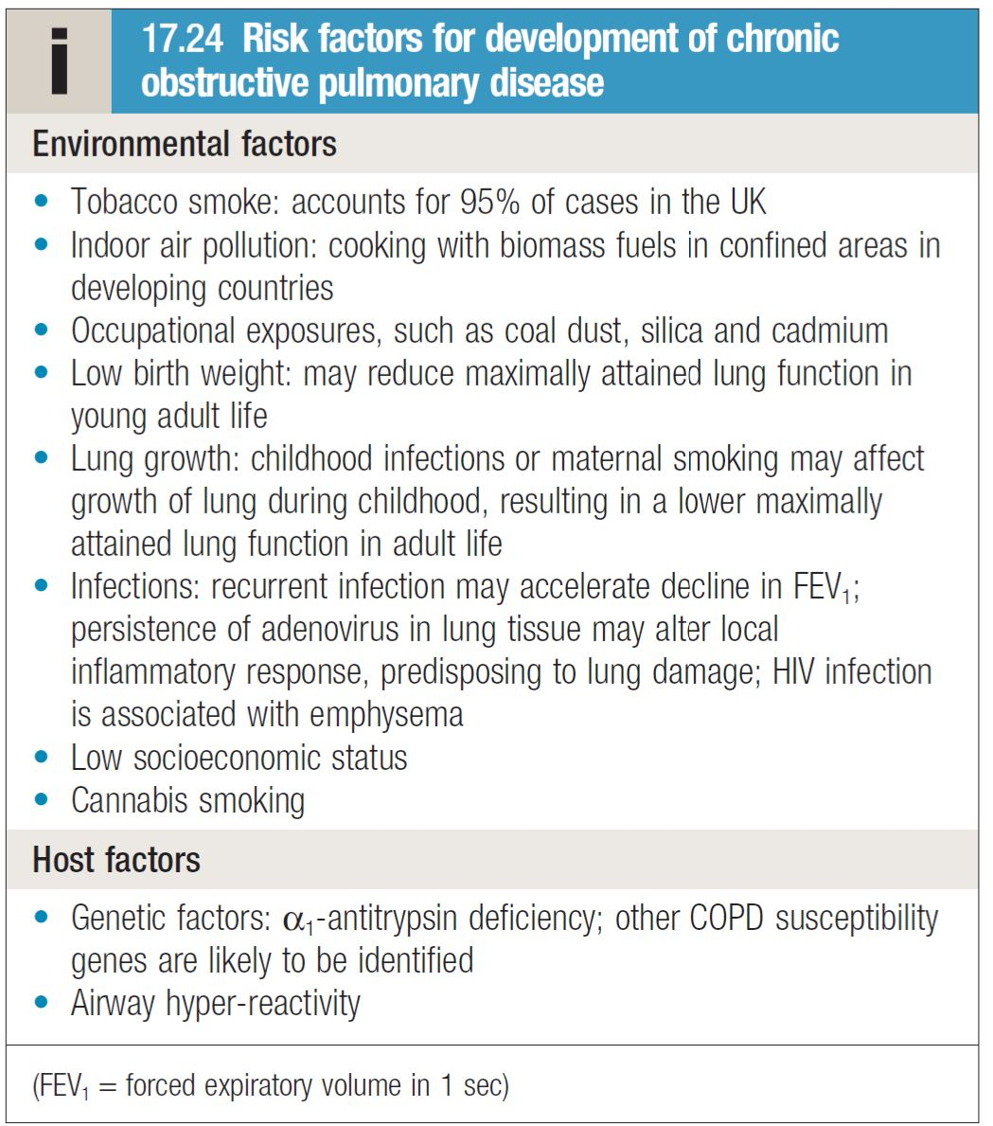
University of Basrah Al-zahraa medical college
Ministry of Higher Education and Scientific Research
Risk factor for COPD:
LO2

Slide 5
University of Basrah Al-zahraa medical college
Ministry of Higher Education and Scientific Research
Pathophysiology
LO2

Slide 6
University of Basrah Al-zahraa medical college
Ministry of Higher Education and Scientific Research
LO3
Clinical features:
COPD should be suspected in any patient over the age of 40 years who presents with symptoms of chronic bronchitis and/or breathlessness
Investigation:
Spirometry
CXR (what are the features by X-ray)
CBC
RFT
Others.

Slide 7
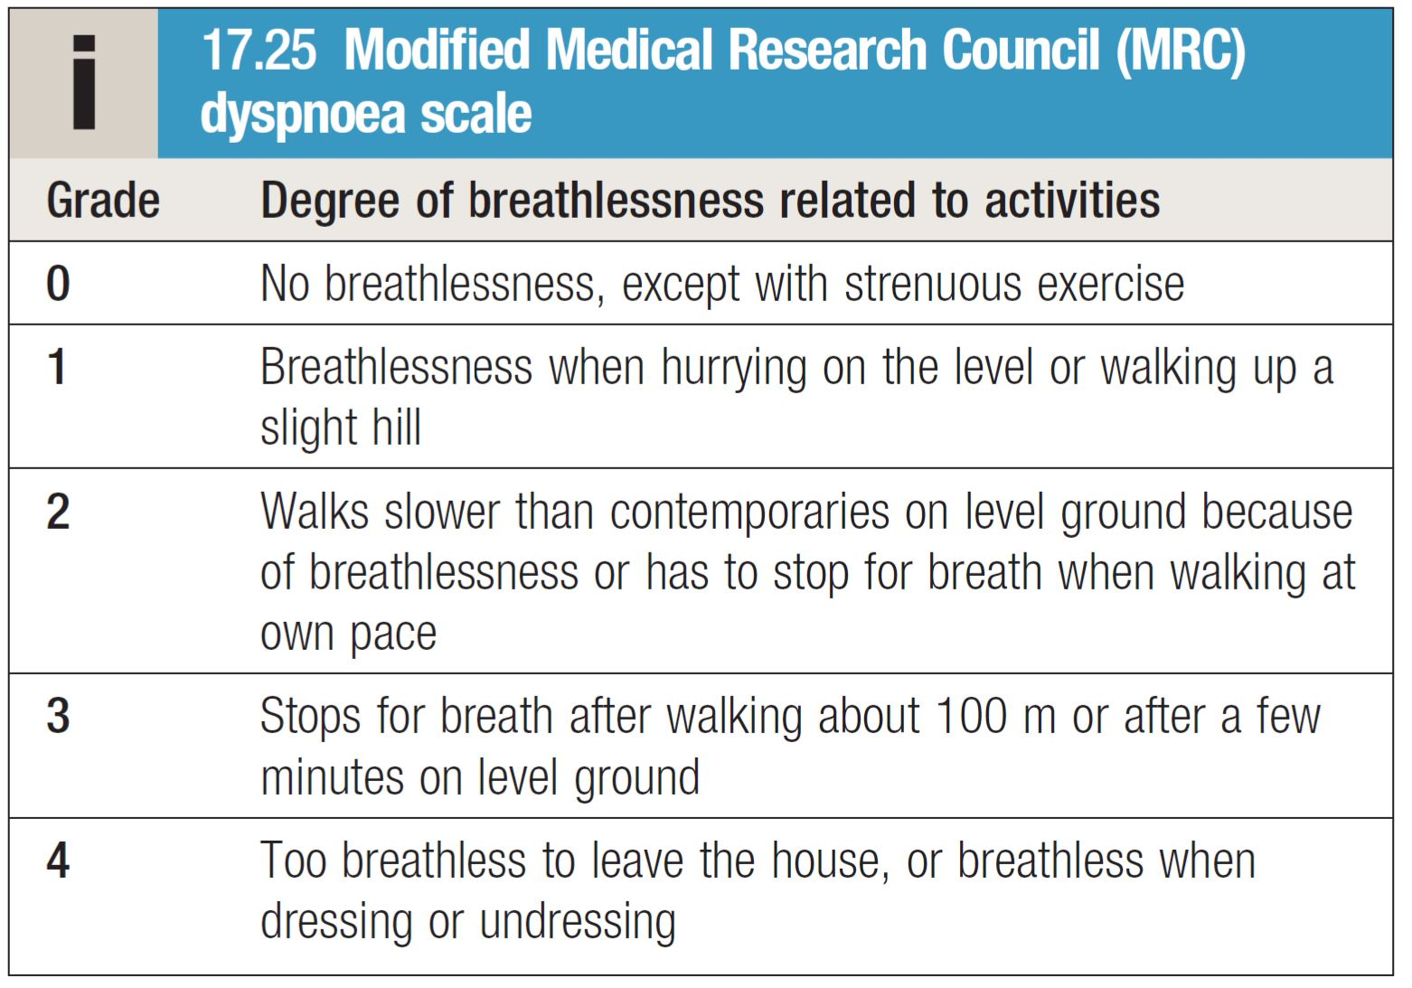
University of Basrah Al-zahraa medical college
Ministry of Higher Education and Scientific Research
Modified medical research counsel (mMRC) scale of dyspnea
LO4

Slide 8
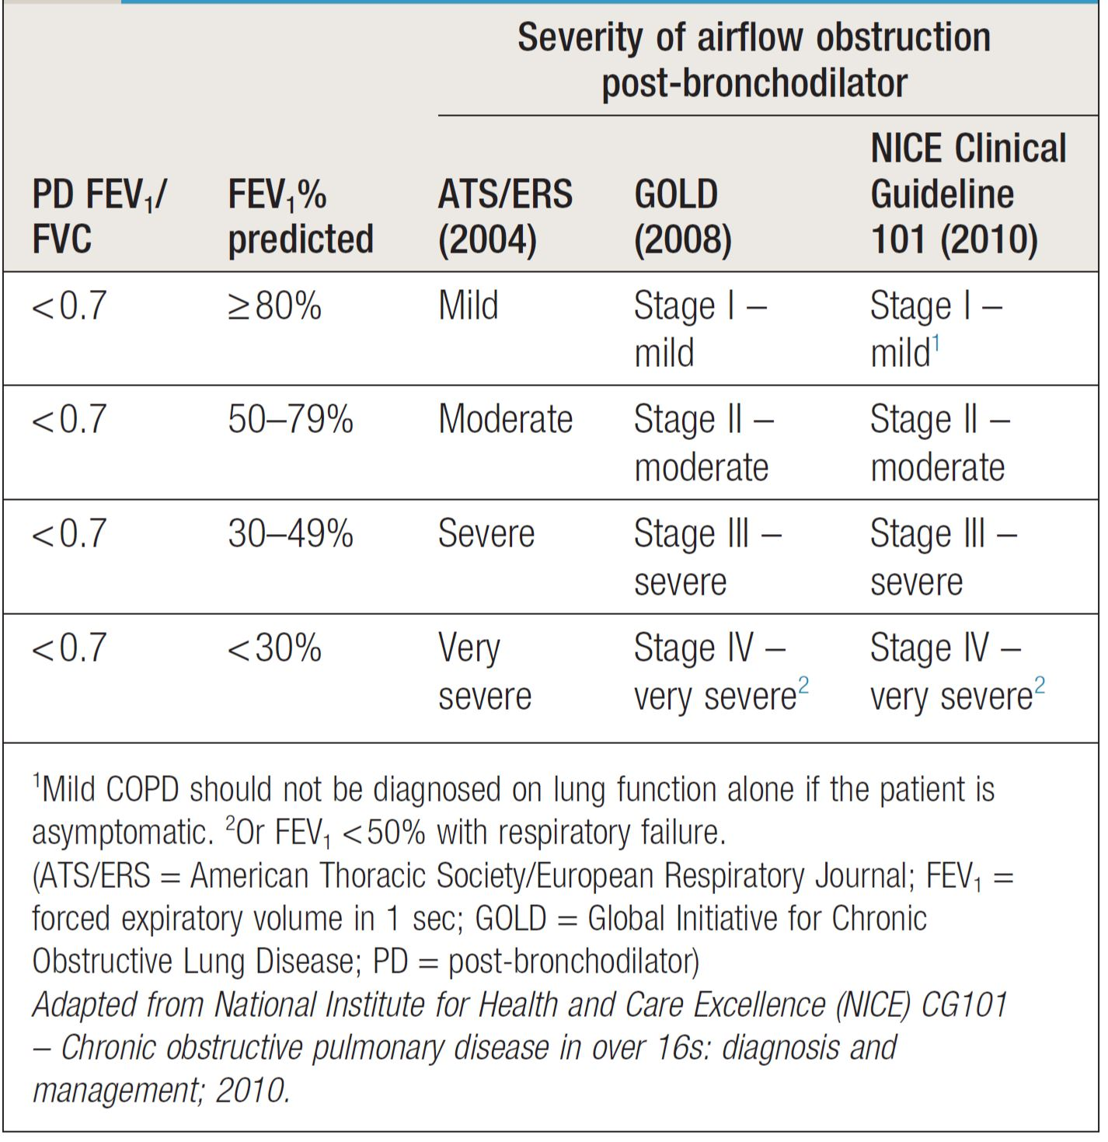
University of Basrah Al-zahraa medical college
Ministry of Higher Education and Scientific Research
LO4

Slide 9
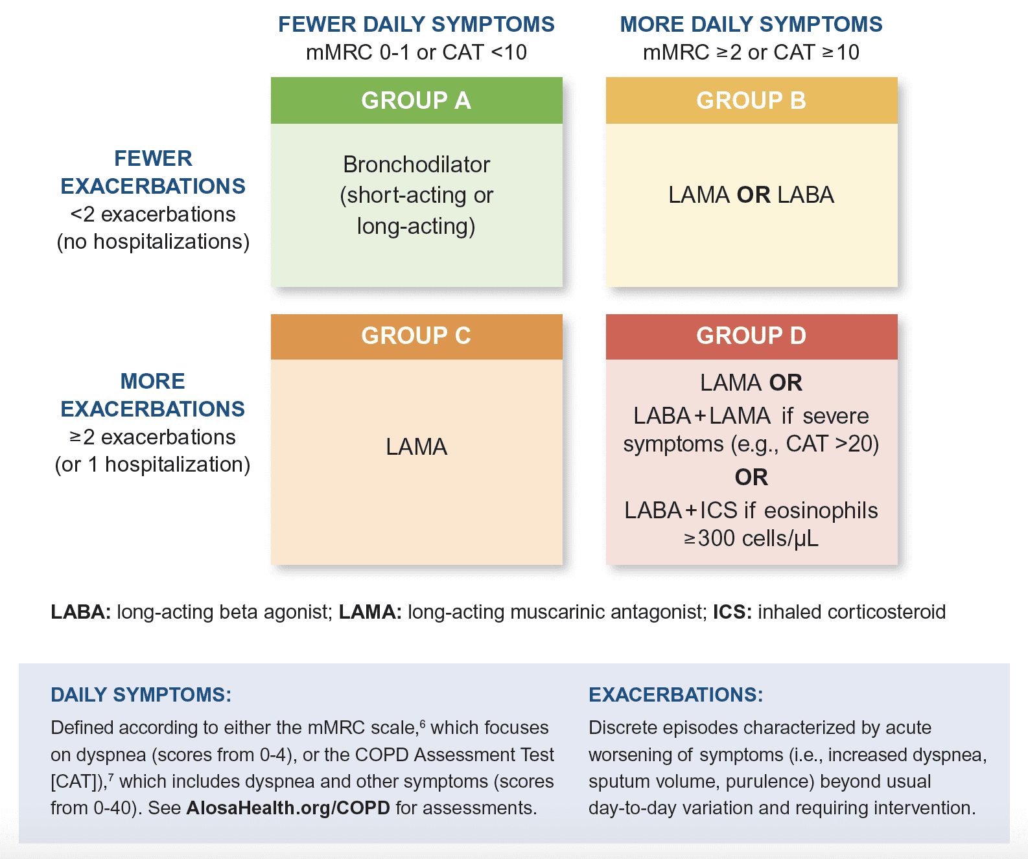
University of Basrah Al-zahraa medical college
Ministry of Higher Education and Scientific Research
LO5

Slide 10
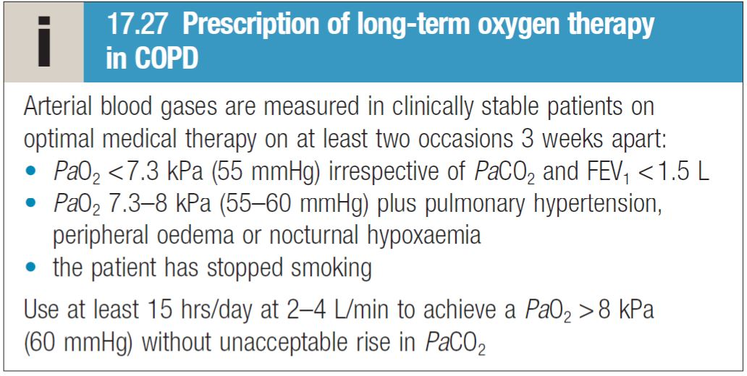
University of Basrah Al-zahraa medical college
Ministry of Higher Education and Scientific Research
Long term oxygen therapy
LO5

Slide 11
University of Basrah Al-zahraa medical college
Ministry of Higher Education and Scientific Research
LO5
Management of COPD exacerbation:
Oxygen therapy
In patients with an exacerbation of severe COPD, high
concentrations of oxygen may cause respiratory depression and worsening acidosis.
Controlled oxygen at 24% or 28% should be used with the aim of maintaining a PaO2 of more than 8 kPa (60 mmHg) (or an SaO2 of more than 90%) without worsening
Bronchodilators
Glucocorticoids
Antibiotic therapy
Non-invasive ventilation
Additional therapy

Slide 12
University of Basrah Al-zahraa medical college
Ministry of Higher Education and Scientific Research
What are the new modalities of treatment of COPD and what are the indications of lung volume reduction surgery in COPD?

Slide 13
University of Basrah Al-zahraa medical college
Ministry of Higher Education and Scientific Research
Thank you

